Slide 1
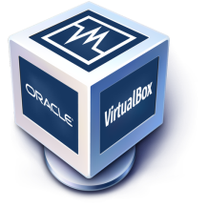


AWS
Important Topics!
Computer
Data
Operating System
Network
Virtualization
Virtual Machine
Cloud

Slide 2
AWS
What is Computer?
Computer is an electronic machine.
CPU > RAM > Hard-disk > SMPS > Mother Board > Cabinet > Monitor > Keyboard and Mouse
Invented by Charles Babbage – 1837.
We can use computer to store, access and transfer our data.
Notes:
Ref : doc.html -> 2 to 17

Slide 3
AWS
How Computer came?
Mankind was in need to store the “Information’s”.
What are those information's? Experiences or something
Why they need to store information's? To pass it to other people or their next
generations
How people started to store information's? Languages>Writings>Inscription& Maple
leaves>Paper!
Notes:
Ref : doc.html -> 2 to 17

Slide 4
AWS
Paper VS Computer
We are migrating from Paper to Computer age!
Floppy
CD/DVD drive
Pen drive
External Hard Disk
Memory cards
Paper | Computer
Need huge storage space | Very less Storage space
Took more time for copy | Very quick in copy / move
Heavy risk | Low risk
Need number of resources | Need low resources
Notes:
Ref : doc.html -> 2 to 17

Slide 5
AWS
How we are handling information's ?
Simple Duplex====> Radio & TV
>Receive from one side
Half Duplex====> walkie -Talkie
>sending and receiving from 2 sides Data!
Full Duplex ====> Landline/Mobile/Internet Communication
>sending and receiving simultaneously from 2 sides

Slide 6
AWS
What is Data?
Collection of information is called Data.
Programs are designed to process and manipulate data, while data serves as the input to these programs and the output produced by them.
A program, in the context of computing, refers to a set of instructions written in programming language that defines a sequence of operations to be performed by a computer.
Collection of program is called Application Software.
>System Software
>Application Software
Operating System = System Software

Slide 7
AWS
Operating System !
Interface between user and machine(Computer)
Resource manager of a computer.
It will manage the processes, memory and files.
Different types of OS !
Linux
Microsoft windows
Apple MAC OS

Slide 8
AWS
How server is controlling client Computer?
Server computers and client computers are connected in “Network”.
We need to configure server computer configuration in client computer.
Client requests will handle by the server and it will respond to the client.

Slide 9
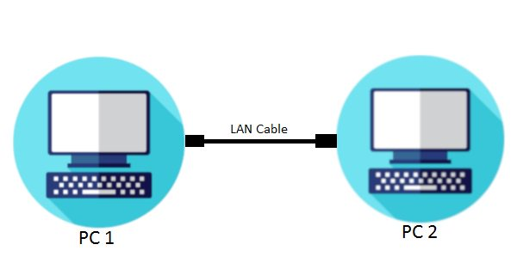
AWS
Data Transfer between Two Computers!
Application>Data>NIC>Packet>Transfer in cable>Packet>NIC>Data>Application
Application Layer | Sending a doc file
Transport Layer | It is segmenting a data into smaller units called segments.
Network Layer | The segments are further encapsulated into packets, it contains source and destination IP address.
Data Link Layer | This layer adds physical address known as MAC and packets are boxed in frame.
Physical Layer | The frames are converted into electrical or optical signals that can be transmitted over the RJ 45 cable.

Slide 10
AWS
Data Transfer between Two Computers!
Reception & Decoding | NIC – It receives the signals and convert them back into Frames.
Data Link | It checks the Mac address, if the frame is for the receiving NIC then frame is accepted else ignored.
Network | It extracts the packet from the accepted frame and checks the destination ip address.
Transport | If above correct, then it will extracts the segments and reassembles them into the original data.
Application | Finally, the data is delivered to application, it will process and use the received information.

Slide 11
AWS
How data Transfer between two computers?
Network Devices
IP Addressing
Subnetting
Public Network
Private Network
Virtual Network
VPN – Virtual Private Network
Notes:
Ref : doc.html -> 1662 to

Slide 12
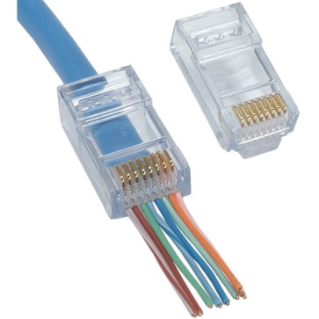
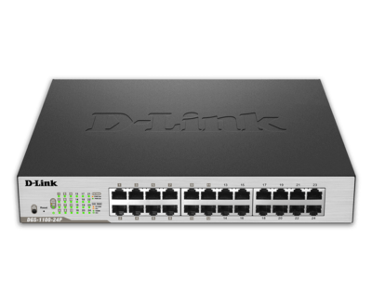
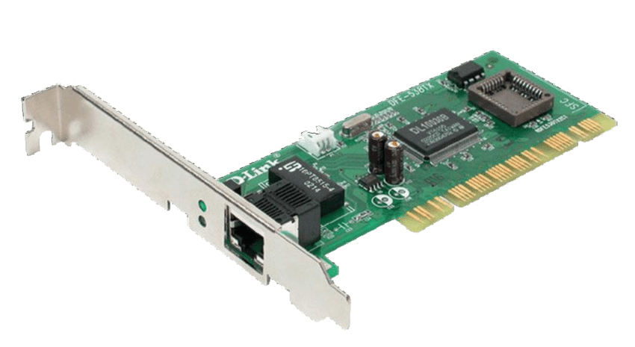
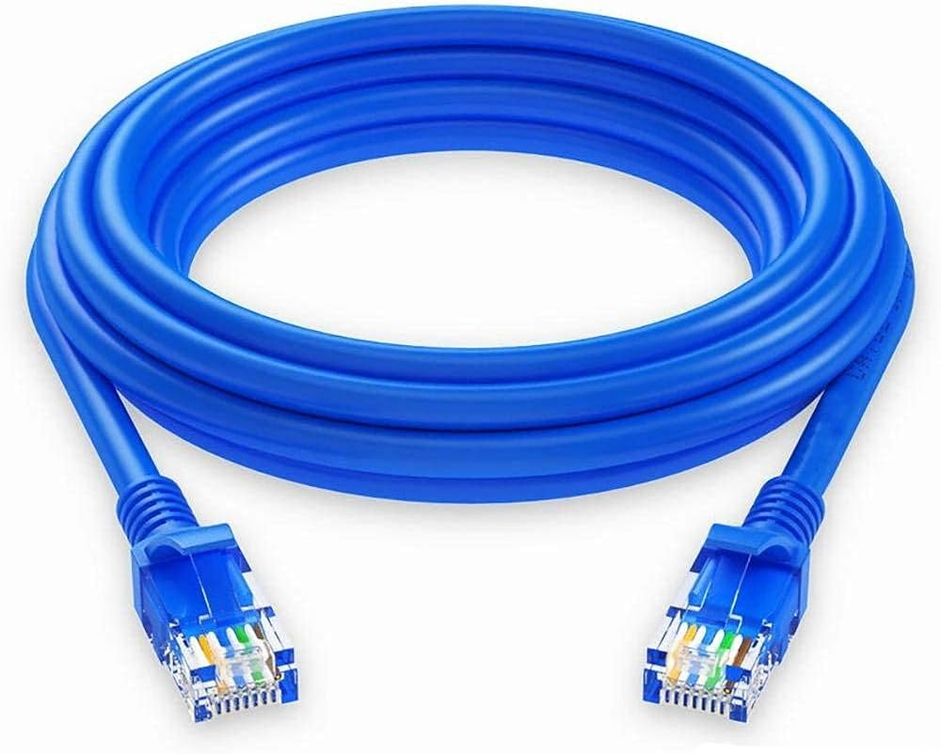

AWS
Network Devices
RJ45
Ethernet cable
NIC- Network interface card
Switch
Router
Internet modem/ Gateway
Notes:
Ref : doc.html -> 1662 to

Slide 13
AWS
Switch
Smart traffic cop for data on a computer network.
Data>Packet>NIC>Switch
Reading the packet source and destination IP
Sending packet to the port>NIC>packet>Data
Notes:
Ref : doc.html -> 1662 to

Slide 14
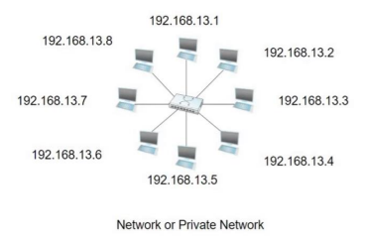
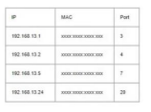
AWS
Example
Notes:
Ref : doc.html -> 1662 to

Slide 15
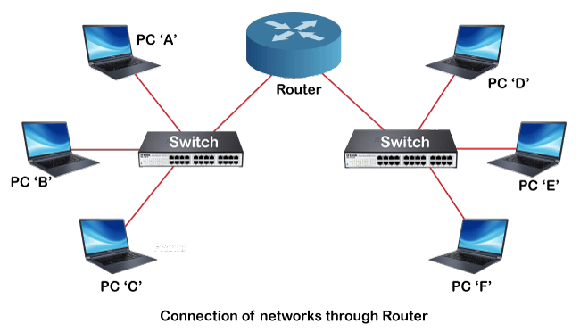
AWS
Router
A Router connects different networks together. It reads data packets , addresses to decide where to send them.
It directs data between devices within your home network and manages traffic between your local network and the Internet.
Notes:
Ref : doc.html -> 1662 to

Slide 16
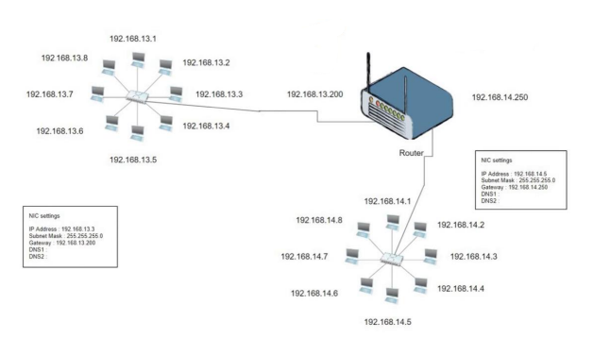
AWS
Router
Notes:
Ref : doc.html -> 1662 to

Slide 17
AWS
How Internet works in our home?
Step1: Browser www.google.com
Step2: DNS-Name to IP conversion
Step3: Public IP will be received by the host
Step4: NIC request the web page to public IP(Packets)
Step5: NIC will receive the response from public IP
Notes:
Ref : doc.html -> 1662 to

Slide 18
AWS
Public IP Range Private IP Range
Class | Start Address | End Address
A | 0.0.0.0 | 126.255.255.255
B | 128.0.0.0 | 191.255.255.255
C | 192.0.0.0 | 223.255.255.255
Class | Start Address | End Address
A | 10.0.0.0 | 10.255.255.255
B | 172.16.0.0 | 172.31.255.255
C | 192.168.0.0 | 192.168.255.255
Notes:
Ref : doc.html -> 1662 to

Slide 19
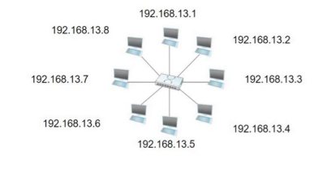
AWS
IP Addressing
An IP(Internet Protocol) address is a numerical label assigned to each device connected a computer network that uses the Internet Protocol for communication. It serves as a unique identifier for devices within a network, allowing them to send and receive data across the internet or other networks.
Notes:
Ref : doc.html -> 1662 to

Slide 20
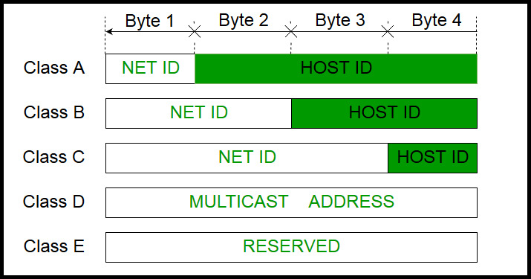
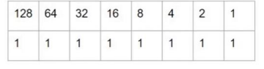
AWS
IP Address Classes & Range
Class | Ranges
A | 1.0.0.1 to 126.255.255.254
B | 128.1.0.1 to 191.255.255.254
C | 192.0.1.1 to 223.255.254.254
D | 224.0.0.0 to 239.255.255.255
E | 240.0.0.0 to 253.255.255.254
255 | 255 | 255 | 255
8bit | 8bit | 8bit | 8bit
Notes:
Ref : doc.html -> 1662 to

Slide 21
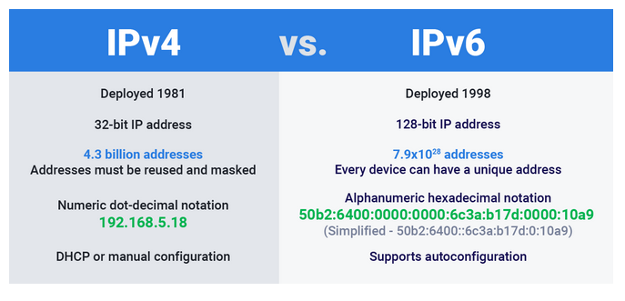
AWS
IPv4 VS IPv6
Notes:
Ref : doc.html -> 1662 to

Slide 22
AWS
Private IP Address - Ranges
10.0.0.1 | 10.0.1.1
10.0.0.2 | 10.0.1.2
----- | ------
10.0.0.255 | 10.0.1.255 | 10.255.255.255
172.16.0.0 | 172.16.1.1
172.16.0.1 | 172.16.1.2
----- | ------
172.16.0. 255 | 172.16.1. 255 | 172.31.255.255
192.168.0.1 | 192.168.1.1
192.168.0.2 | 192.168.1.2
----- | -----
192.168.0.255 | 192.168.0.255 | 192.168.255.255
Notes:
Ref : doc.html -> 1662 to

Slide 23
AWS
Subnetting
In networking, it means taking a large group of IP addresses and splitting them into smaller groups called subnet. This helps manage and organize devices on a network more efficiently, allowing different parts of the network to be treated separately while still being connected.
Benefits
Security
Performance
Simplified N/W Management
East to solve the network issue
Notes:
Ref : doc.html -> 1662 to

Slide 24
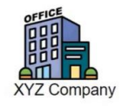
AWS
Example
Department | Members | Network id- Subnet mask- IP range
Human Resource | 10 | 192.168.13.0-255.255.255.240-192.168.13.1 to 192.168.13.14
Sales& Marketing | 10 | 192.168.13.16-255.255.255.240-192.168.13.17 to 192.168.13.30
Production | 50 | 192.168.13.32-255.255.255.192-192.168.13.33 to 192.168.13.94
IT Team | 8 | 192.168.13.96-255.255.255.240-192.168.13.97 to 192.168.13.110
Finance | 5 | 192.168.13.112-255.255.255.248-192.168.13.113 to 192.168.13.118
Notes:
Ref : doc.html -> 1662 to

Slide 25
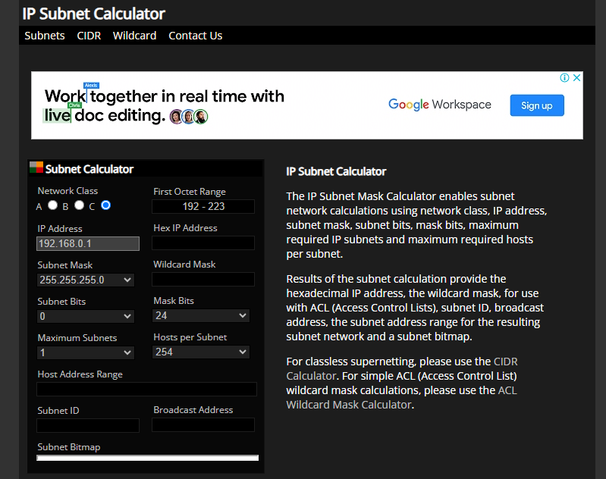
AWS
Notes:
Ref : doc.html -> 1662 to

Slide 26
AWS
What is Port Number?
Port Number is an essential part of the Transport Layer in the Internet Protocol(IP) suite and are used to enable communication between different applications or service on the same computer or between computers on a network.
When data is sent over a network using the Transmission Control Protocol or the User Datagram Protocol, it is addressed to a specific IP address and port number. The combination of IP address and port number helps the network stack on the receiving end route the data to the appropriate application or service running on that device.
Notes:
Ref : doc.html -> 1662 to

Slide 27
AWS
Port numbers range from 0 to 65535.
They are divided into three categories:
Well known ports(0-1023): Reserved for commonly used services like HTTP(port 80) FTP(port 21) and SMTP(port 25).
Registered ports(1024-49151): Used by applications and services that aren’t as widely recognized but are still officially registered with the Internet Assigned Numbers Authority(IANA).
Dynamic or Private Ports(49152-65535): Available for use by applications and services on a temporary or ad-hoc basis
Notes:
Ref : doc.html -> 1662 to

Slide 28

AWS
Example
Your family informed you that, your “Fav” actor stayed in hotel in your area for shooting.
Now you are trying to meet him.
And, you found the receptionist is your friend.
You are asking about the actor stay to your friend receptionist.
He said , he is staying in 6th room and you can go and meet him.
You met your “Fav” actor and happily informed your family.
Actor = Destination Service
Hotel = IP Address
Port = Room Number
Packets = You
Notes:
Ref : doc.html -> 1662 to

Slide 29
AWS
What is Port Forwarding?
Port Forwarding is a networking technique that allows you to redirect incoming network traffic from one port on a router or Firewall to another port on a different devices in your local network.
Inside your local network, you have various devices(computer, servers, Iot devices) that run services and applications. Each of these devices may have a Private IP address.
You can configure your router or firewall to forward incoming traffic on a specific port(external port) to a specific device and port on your local network(internal port).
This configuration tells the router/firewall how to route incoming traffic to the correct destination.
Notes:
Ref : doc.html -> 1662 to

Slide 30
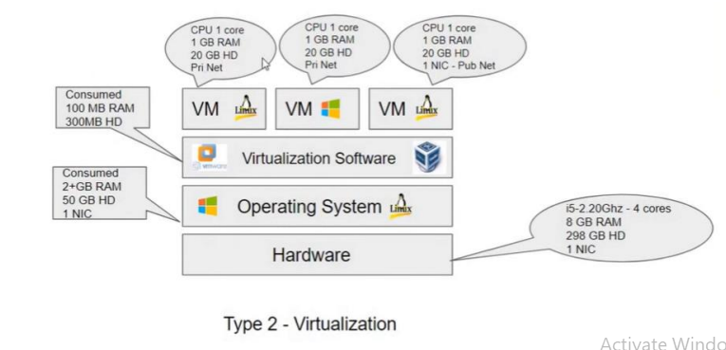
AWS
Virtual box – Networking Modes
Mode | VM →Host | VM← Host | VM1 <--->VM2 | VM→ Net/LAN | VM← Net/LAN
Host – Only | + | + | + | - | -
Internal | - | - | + | - | -
Bridged | + | + | + | + | +
NAT | + | Port forward | - | + | Port forward
NAT service | + | Port forward | + | + | Port forward
Notes:
Ref : doc.html -> 1662 to

Slide 31
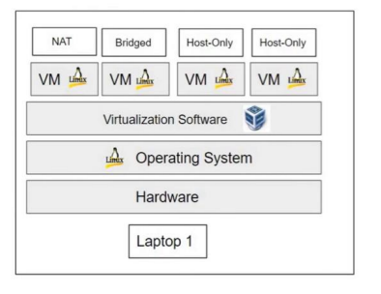
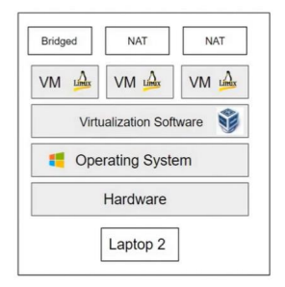
AWS
Example
Notes:
Ref : doc.html -> 1662 to

Slide 32
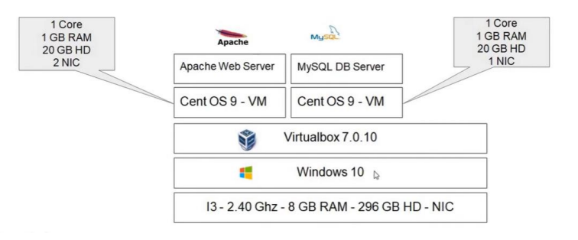
AWS
Test Environment – Plan & Build
Test Environment – Plan :
Steps:
Install Virtual box
VM Network setup
> Including port forwarding setup
Create and configure new virtual machine
VM Backup & Restore
SSH (putty) and FTP (WinSCP) connection setup
Notes:
Ref : doc.html -> 1662 to

Slide 33
AWS
Virtual box Setup
Step1: Remove unwanted applications and files to free up space.
Step2: Download Virtual box setup from www.virtualbox.org site.
Step3: Install the setup file.
Virtual box Network Setup
Step1: Virtual box > Tools > Network
Step2: NAT Networks > Create New > Configure IP Address setup
Step3: Port Forwarding > Configure SSH and Web port forwarding setup
Notes:
Ref : doc.html -> 1662 to

Slide 34
AWS
Virtual Machine Setup
Step1: Download CentOS Stream 9 ISO file from www.centos.org.
Step2: Create Virtual Machine.
Step3: Install Cos Stream 9 ISO file in Virtual Machine.
Virtual Machine Network Setup
Step1: Ensure the network Adapter for Bridged Network.
>This is for web server VM and we need internet access for our VM
> Please consider this is Public Network
Step2: Configure “NAT Network”
> This is for Database Server VM and only web server host should access the VM
> It should have Internet access and consider this as Private Network
Notes:
Ref : doc.html -> 1662 to

Slide 35
AWS
Virtual Machine Backup & Restore Setup
Step1: Take VM snapshot.
It will capture a state of a VM
We can take clone from a VM snapshot
Step2: Take VM clone
This will save time to create new VM
It will be backup of our VM setup
SSH and FTP Connection Setup
Download “Putty” software tool to create SSH connection
Download WinSCP for “File Transfer” support
Let me show you the Live configuration !
Notes:
Ref : doc.html -> 1662 to

Slide 36
AWS
Topics!
Hostname Setting
IP Address Setting
Checking the Time & Date , System & OS information
Understanding the Directory Structure
Basic User Management
Basic File Management
Basic Package Management

Slide 37
AWS
Hostname Setting
Step1: Type “hostname <provide your name>”
Step2: Check the provided hostname, type “hostname”
Step3: We need to open “/etc/hostname” file and write our hostname.
IP Address Setting
Step1: Type “nmtui”
Step2 : “Edit connection” > Select N/W card> configure> OK> Back> Activate the connection
Notes:
Ref : doc.html -> 1662 to

Slide 38
AWS
Date , System & OS Information
Type “Date”
Type “uname-a” , it will show below important details
>Hostname, Processor Architecture, Kernel and Date
Type “cat/proc/version” for some more information about Linux
To check RAM details, Type “cat/proc/meminfo” or “top” command
To check HD details, Type “cat/proc/partitions” and “df – h” command
Notes:
Ref : doc.html -> 1662 to

Slide 39
AWS
Directory Structure
/-slash → It is the parent directory for all other file and folders. Only root user is having permission to makes changes.
/home → It contains normal user profiles. By default, normal users don’t have permission to make changes in other folder.
/boot → It contains Linux OS bootable files. GRUB2 Loader and VMLINUZ – Kernel files.
/bin → It contains binary files for the normal users.
/sbin → It contains binary files for the root user.
/etc → It contains system and server configuration files.
/dev → It contains system’s device file informations.
Notes:
Ref : doc.html -> 1662 to

Slide 40
AWS
Basic User Management
Usually a user is a Person. A User account contains permissions to perform operations in the operating system.
→ 3types of user “root user” – “normal user” – “service user”
We know, how to login in OS after the boot process but how to switch user account in same terminal?
→ Type “su <username>” and provide password
Notes:
Ref : doc.html -> 1662 to

Slide 41
AWS
How to add new user? – How to assign password to the new user? – How to check the user information's?
→ Type “useradd <new user>”- Type “passwd <new password>”- Open”/etc/passwd” file
How to create a group? – How to add user in the group? – How to check group information's?
→ Type ”groupadd<new group name>” – Type “usermod –aG <group name> <user name> - Open”/etc/group”
Notes:
Ref : doc.html -> 1662 to

Slide 42
AWS
Basic File Management
Type “pwd” – To check the present working directory.
Type “ls” – To check files in the directory.
Type “cd<provide location> - To move other directory location
Type “mkdir<provide location> - To create new directory
Type “touch <name> - To create empty files
Type “cp<file name>/ <location>/<new file name>/”- To copy the files to some other location
Notes:
Ref : doc.html -> 1662 to

Slide 43
AWS
Type “cp –r<folder name>/<location>/<new folder name>/” – To copy the files to some other location
Type “mv <file name>/<location>/<new file name>/” – To move the files to some other location
Type “rm <file name>” - To delete the file
Type “rm -r<folder name>” – To delete the folder or rmdir <FolderName>
Notes:
Ref : doc.html -> 1662 to

Slide 44
AWS
Basic File management – File Editor
CAT
Cat <file name> - Help us to shown the content from the file.
Cat> <file name> - Help us to write or overwrite from the file.
Cat>> <file name> - Help us to add on new lines from existing file content.
VI
Vi<file name> - Help us to show, edit, save the content from the file in separate editor mode.
1. Enter I or i – to start help us to inserting in document
:w – Save the file
:q – exit the editor, if the file has been modified use the following command.
Notes:
Ref : doc.html -> 1662 to

Slide 45
AWS
:q! – exit the editor without saving
:wq – exit the editor and save the file
: set nu – setting numbers to each line
:search – searching the words
VIM
If you have not installed VIM package kindly install the Vim using ”yum install vim –v”.
Vim also having same features as VI editor.
It has new feature of showing contents in colour full styles.
Notes:
Ref : doc.html -> 1662 to

Slide 46
AWS
Basic Package Management
How to manage packages in centos with YUM?
1.YUM(Yellowdog Updater Modified):
Yum is one of the older package managers and was widely used in Red Hat Enterprise Linux (RHEL) and its derivatives.
Yum resolves package dependencies automatically. If a package relies on other packages, Yum will find and install those dependencies for you.
It works with “repositories” which are online locations that stores software packages.
You can use YUM to install, remove or update packages with simple commands,
Notes:
Ref : doc.html -> 1662 to

Slide 47
AWS
yum install package_name
yum update package_name
yum remove package_name
How to manage Packages in Centos with DNF?
DNF(Dandified YUM) is the next-generation package manager, designed to replace YUM in newer version of Hat-based systems.
Like YUM, DNF manages packages from repositories, but it offers improved performance and feature.
DNF uses more modern architecture, which makes it faster and more reliable than YUM.
You can perform operations like package installation or updates using DNF, just as You would with YUM.
Notes:
Ref : doc.html -> 1662 to

Slide 48
AWS
Web Application for Test Environment
Steps to follow:
Step1: Install and configure Apache HTTPd and PHP service in web server host
Step2: Install and configure MySQL Database in DB Server
Step3: Design your Application in PHP
Step4: Write your Application code in PHP
Step5: Understand, How the application works in local environment?
Step6: Deploy and Test your application
Notes:
Ref : doc.html -> 1662 to

Slide 49
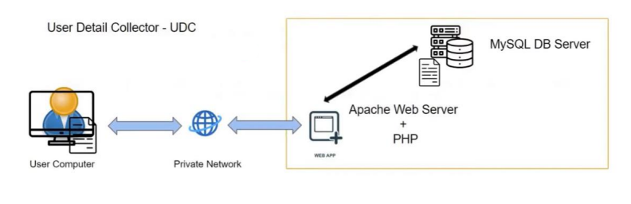
AWS
Domain Name Service
It is used for name to IP conversion and Ip to name conversion
We need to configure DNS temporarily for this project in Windows and Linux
Design Your Application
User Detail Collector – UDC
Notes:
Ref : doc.html -> 1662 to

Slide 50

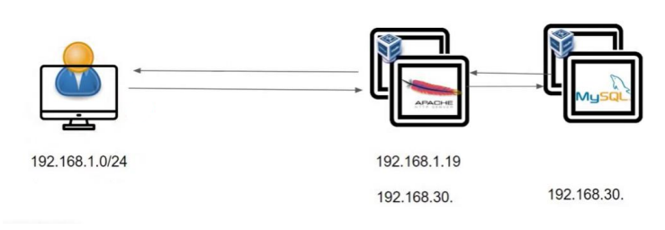
AWS
Write your application
I have already written the code in PHP so please download the PDF document and follow the steps with me
How Application Works?
Notes:
Ref : doc.html -> 1662 to

Slide 51
AWS
Deploy the Application
Step 1: Prepare MYSQL DB for our PHP application.
Step 2: Ensure the connectivity with PHP – DB.
Step 3: Paste the PHP code in required location.
Step 4: Restart the required services and check the service status.
Step 5: Access the PHP application from user end.
Notes:
Ref : doc.html -> 1662 to

Slide 52

AWS
Please refer the UDC.pdf file for full set of configuration
Notes:
Ref : doc.html -> 1662 to

Slide 53
AWS
Configure Temporary DNS
Now your are able to access the PHP web-app in browser with IP address.
How to configure temporary DNS in Windows and Linux?
Why we are configuring this now?
Notes:
Ref : doc.html -> 1662 to

Slide 54
AWS
Configure Domain Name Server in Windows :
1. Open Run Panel and type system32
2. Open drivers folder
3. Under drivers -> etc folder
4. Under etc -> hosts
5. Open the hosts file with read and write access (Properties – Security - Users(jayanth Lenovo) – Edit – Full control – allow – close)
6. Open the file in Notepad and enter your IP and domain new name and save it.
Notes:
Ref : doc.html -> 1662 to

Slide 55
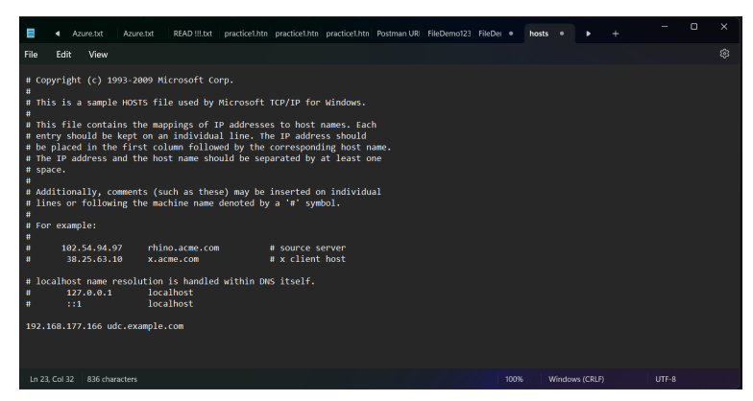
AWS
Notes:
Ref : doc.html -> 1662 to

Slide 56
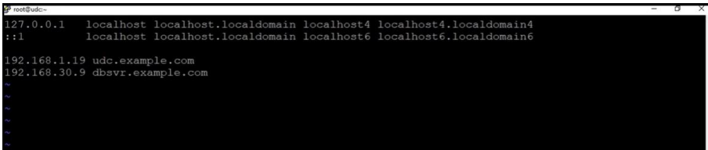
AWS
Configure Domain Name Server in Linux :
Vi /etc/hosts
2.
3. Save it (wq!)
Notes:
Ref : doc.html -> 1662 to

Slide 57
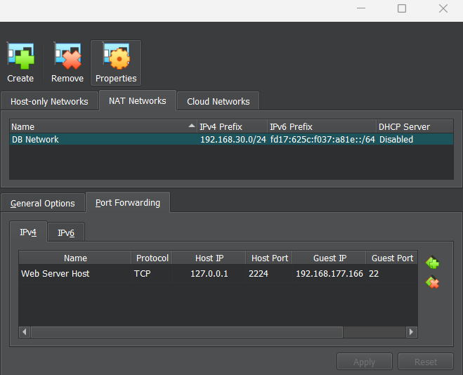
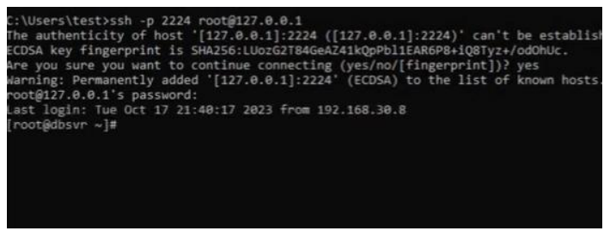
AWS
Port Forwarding :
Notes:
Ref : doc.html -> 1662 to

Slide 58
MySQL
MySQL

Slide 59
MySQL
What is SQL?
SQL is Structured Query Language, which is a computer language for storing, manipulating and retrieving data stored in a relational database.
What is RDBMS?
RDBMS stands for Relational Database Management System. RDBMS is the basis for SQL, and for all modern database systems like MS SQL Server, IBM DB2, Oracle, MySQL, and Microsoft Access.

Slide 60
MySQL
SQL Sub Languages
DDL - Data Definition Language
1. Create 2. Alter 3. Drop
DML - Data Manipulation Language
1. Select 2. Insert 3. Delete 4. Update
DCL - Data Control Language
1. Grant 2. Revoke
TCL - Transaction Control Language
1. Commit 2. Rollback 3. Savepoint
Notes:
Ref Note : 1 to 233

Slide 61
MySQL
Database Normalization
Database normalization is the process of efficiently organizing data in a database. There are two reasons of this normalization process −
Eliminating redundant data, for example, storing the same data in more than one table.
Ensuring data dependencies make sense.
First Normal Form (1NF)
Second Normal Form (2NF)
Third Normal Form (3NF)

Slide 62
MySQL
SQL – Datatypes
Datatype | Use
INT | used for columns which will store integer values.
FLOAT | used for columns which will store float values.
DOUBLE | used for columns which will store float values.
VARCHAR | used for columns which will be used to store any characters and integers, basically a string.
CHAR | used for columns which will store char values(single character).
DATE | used for columns which will store date values.
TEXT | used for columns which will store text which is generally long in length. For example, paragraph’s.

Slide 63
MySQL
SQL – Operators
Operator | Description
= | Equal to
!= | Not Equal to
< | Less than
> | Greater than
<= | Less than or Equal to
>= | Greater than or Equal to
BETWEEN, Not BETWEEN | Between a specified range of values
LIKE | This is used to search for a pattern in value.
IN, Not IN | In a given set of values
Union, Union All | used to combine the result-set of two or more SELECT statements.
Notes:
Ref notes : 705 to 715 & 301(like) to 330(between) & 360 to 412 (Union)

Slide 64
MySQL
SQL Constraints
Constraints are the rules enforced on data columns on a table.
NOT NULL Constraint − Ensures that a column cannot have a NULL value.
DEFAULT Constraint − Provides a default value for a column when none is specified.
UNIQUE Constraint − Ensures that all the values in a column are different.
PRIMARY Key − Uniquely identifies each row/record in a database table.
FOREIGN Key − Uniquely identifies a row/record in any another database table.
CHECK Constraint − The CHECK constraint ensures that all values in a column satisfy certain conditions.
INDEX − Used to create and retrieve data from the database very quickly.
Notes:
Ref Notes : 445 to 697

Slide 65
MySQL
Difference Between Drop, Delete and Truncate
Delete | Truncate | Drop
Delete is a DML command | Delete is a DDL command | Delete is a DDL command
Delete is used to delete the particular records in the table | Truncate is used to delete the entire table data and keep the table structure as it is | Drop is used to drop the entire table data with structure
Delete statement use the where clause to delete particular records | Truncate can’t use with where clause | Drop can’t use with where clause
Delete statement can be rollback before the commit | Can’t rollback | Can’t rollback
Notes:
Ref notes : 89 to 113

Slide 66
MySQL
SQL Aggregate Functions
COUNT - counts how many rows are in a particular column.
SUM - adds together all the values in a particular column.
MIN, MAX - return the lowest and highest values in a particular column, respectively.
AVG calculates the average of a group of selected values.
Notes:
Ref notes : 339 to 357

Slide 67
MySQL
The SQL SELECT DISTINCT Statement
The SELECT DISTINCT statement is used to return only distinct (different) values.
Example
SELECT DISTINCT Country FROM Customers;
SQL Aliases
SQL aliases are used to give a table, or a column in a table, a temporary name.
Example
SELECT CustomerID AS ID
FROM Customers;
Notes:
Ref notes : 748 to 750 & 699 to 701

Slide 68
MySQL
SQL CREATE VIEW Examples
Generally it creates temporary shorthand name for particular whole query.
The following SQL creates a view that shows all customers from Brazil:
Example
CREATE VIEW [Brazil Customers] AS
SELECT CustomerName, ContactName
FROM Customers
WHERE Country = 'Brazil';
Notes:
Ref notes : 716 to 737

Slide 69
MySQL
SQL CASE Statement
The CASE statement goes through conditions and returns a value when the first condition is met (like an IF-THEN-ELSE statement). So, once a condition is true, it will stop reading and return the result. If no conditions are true, it returns the value in the ELSE clause.
If there is no ELSE part and no conditions are true, it returns NULL.
CASE Syntax
SELECT OrderID, Quantity, CASE WHEN Quantity > 30 THEN 'The quantity is greater than 30' WHEN Quantity = 30 THEN 'The quantity is 30' ELSE 'The quantity is under 30' END
AS QuantityResult FROM OrderDetails;
Notes:
Ref notes : 413 to 422

Slide 70
MySQL
SQL ORDER BY
The ORDER BY keyword is used to sort the result-set in ascending or descending order.
Syntax
SELECT column1, column2, ...
FROM table_name
ORDER BY column1, column2, ... ASC|DESC;
Notes:
Ref notes : 425 to 443

Slide 71
MySQL
The SQL HAVING Clause
The HAVING clause was added to SQL because the WHERE keyword cannot be used with aggregate functions.
Syntax
SELECT column_name(s)
FROM table_name
WHERE condition
GROUP BY column_name(s)
HAVING condition
ORDER BY column_name(s);
Notes:
Ref notes : 767 to 782

Slide 72
MySQL
SQL GROUP BY
The GROUP BY statement is often used with aggregate functions (COUNT(), MAX(), MIN(), SUM(), AVG()) to group the result-set by one or more columns.
Syntax
SELECT column_name(s)
FROM table_name
WHERE condition
GROUP BY column_name(s)
ORDER BY column_name(s);
Notes:
Ref notes : 753 to 765

Slide 73
MySQL
MySQL Subqueries Statement
You can write a query with in a query in MySQL this is known as a subquery.
Usually, a sub query is embedded within the where clause.
A subquery is used to return data that will be used in the main query as a condition to further restrict the data to be retrieved.
Following are the rules to be followed while writing subqueries −
The subqueries must be enclosed within parentheses.
An ORDER BY command cannot be used in a subquery, we can use the GROUP BY clause instead.
A subquery cannot be immediately enclosed in a set function.
Notes:
Ref notes : 784 to 794

Slide 74
MySQL
SQL JOIN
A JOIN clause is used to combine rows from two or more tables, based on a related column between them.
Different Types of SQL JOINs
CROSS JOIN: combines each row from the first table with each row of the second table.
NATURAL JOIN: which is based on column having same name and same datatype present in both the tables to be joined.
INNER(Equi) JOIN: Returns records that have matching values in both tables
LEFT (OUTER) JOIN: Returns all records from the left table, and the matched records from the right table
RIGHT (OUTER) JOIN: Returns all records from the right table, and the matched records from the left table
FULL (OUTER) JOIN: Returns all records when there is a match in either left or right table
Notes:
Ref notes : 797 to 835

Slide 75
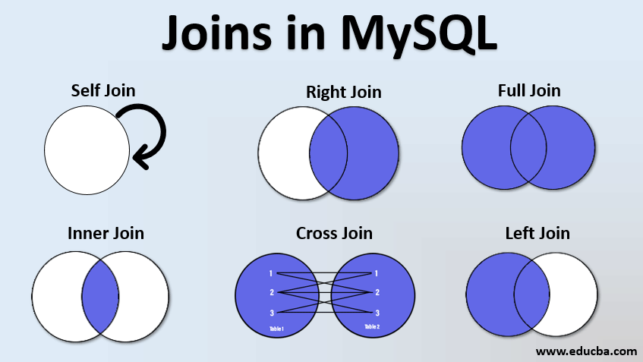
MySQL
SQL JOIN

Slide 76
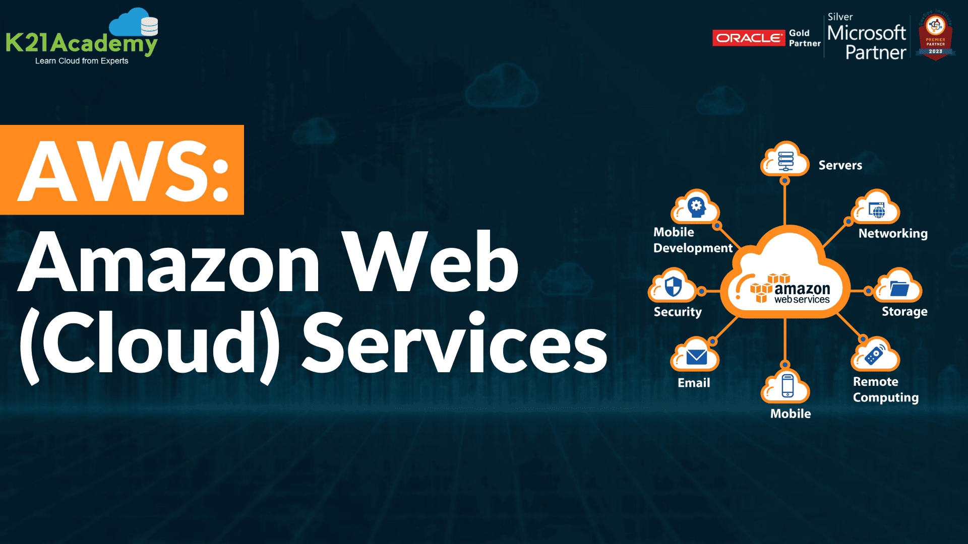
AWS
Notes:
Ref : doc.html -> 1662 to

Slide 77
AWS
Amazon Web Services
AWS is a comprehensive cloud computing platform.
AWS provides a wide range of cloud services, including computing, storage,
Databases, content delivery, machine learning and analytics as services to help individuals, businesses and organizations.
They will build and deploy scalable and cost-effective applications and services in AWS.
Notes:
Ref : doc.html -> 1662 to

Slide 78
AWS
What is Cloud Computing?
Cloud computing is a technology that allows you to access and use computer services and resources like storage , processing power, and software, over the internet, rather than on your local computer.
It’s is like renting or sharing a computer infrastructure with others, and you can use as much or as little as you need.
Common examples of cloud services include online storage(example-Dropbox), web-based email (example-Gmail), and cloud platforms like Amazon Web Service (AWS) or Microsoft Azure for business to run applications and store data.
Notes:
Ref : doc.html -> 1662 to

Slide 79
AWS
Why Cloud Computing?
Quick Infrastructure Deployment
Scalability and Flexibility
Cost savings
Prevent Data Loss
Advanced Security
Notes:
Ref : doc.html -> 1662 to

Slide 80
AWS
Virtualization connection with Cloud Computing?
Virtualization technology plays a fundamental and interconnected role in cloud computing.
Foundation of Cloud Infrastructure:
Virtualization is a underlying technology that enables the creation of virtual machines or
virtual environments within a single physical server or across multiple physical server.
cloud computing relies heavily on virtualization to create a building blocks for cloud Infrastructure.
It often involves the use of virtualization technologies within data centers to create and
manage virtual servers, storage and networking.
Notes:
Ref : doc.html -> 1662 to

Slide 81
AWS
Data Center
Data centers are physically facilities that contains servers, networking equipment, and storage.
Multiple data centers can be used for redundancy and high availability. Data and applications can be replicated or distributed across different data centers to ensure continuity in case of failures or disasters.
Managing multiple data centers can be complex and costly, as it involves maintaining hardware, networking and power infrastructure.
Notes:
Ref : doc.html -> 1662 to

Slide 82
AWS
AWS - Architecture
AWS architecture is the structure and layout of AWS services and components that work together to create a scalable and reliable cloud computing environment.
Mainly, below three we need to know
Regions
Availability Zones Global Infrastructure
Edge Locations
Notes:
Ref : doc.html -> 1662 to

Slide 83
AWS
Availability Zone
Availability Zone
Availability Zones are like separate data centers in the same city.
AWS sets up multiple availability zones in each AWS region, and they are located close to each other but designed to be physically isolated from one another.
They provide redundancy and fault tolerance. If one availability zone experiences an issue, your data or applications can continue running in another without disruption.
You can think of availability zones as AWS’s way of making sure your applications and data are highly available and reliable.
Notes:
Ref : doc.html -> 1662 to

Slide 84
AWS
Edge Location
Edge Location
Edge locations are like small data centers located in different cities and regions around the world.
They are part of Amazon Cloud Front, which is content delivery network(CDN) service provided by AWS.
Edge Locations store cached copies of frequently accessed data, like images and videos, to reduce the load on the main server.
When a user requests content, it’s served from the nearest edge location, which makes the content load faster and reduces the load on the central server.
Edge locations are crucial for delivering web content quickly to users all over the globe.
Notes:
Ref : doc.html -> 1662 to

Slide 85
AWS
Things required to create AWS account
E-mail address
Phone Number
Credit or Debit Card
Visit “aws.amazon.com” to create your account
Notes:
Ref : doc.html -> 1662 to

Slide 86

AWS
Identity and Access Management
IAM
What is IAM?
Users
Groups
Roles
Policies
IAM Account Settings
Notes:
Ref : doc.html -> 1662 to

Slide 87
AWS
What is IAM?
IAM helps you to manage users and their level of access in AWS.
Create users and assign permissions
Create groups and roles
Control access to AWS resources (like S3, EC2)
We have two types of AWS user account.
Root account – It is associated with your email address. The account owner with complete access to all AWS service and resources. You’re the root user if you created the AWS account and you sign in using your root user email and password.
IAM user- The IAM user represents the human user or workload who uses the IAM user to interact with AWS service.
Notes:
Ref : doc.html -> 1662 to

Slide 88
AWS
Roles and Policies
AWS IAM roles and policies are fundamental components of Amazon Web Service (AWS) that help control and manage access to AWS resources.
IAM roles determine who gets access to AWS resources, and IAM policies define what they can do with that access. Roles and policies work together to help you manage and secure your AWS environment by ensuring that only authorized entities have the right level of access to AWS services and data.
Notes:
Ref : doc.html -> 1662 to

Slide 89
AWS
IAM Roles
It is predefined sets of permissions that you can assign to AWS resource.
These roles help ensure secure access to AWS resources by granting permissions on temporary and as- needed basis.
IAM Policies
IAM policies are like rulebooks that specify what actions are allowed or denied for AWS users or resources.
Policies are written in JSON format and define the permissions associates with roles, users, groups.
These policies are used to control who can do what within AWS, which resources they can access, and under what conditions.
Notes:
Ref : doc.html -> 1662 to

Slide 90
AWS
What we are going to do now?
Create a group and assign any AWS resource permission.
Create new user and assign this user to the group.
Try to login via new IAM user and check the permissions.
Understand programmatic access and IAM account settings.
Install and configure AWS CLI using new user account.
Note: IAM is not region specific, it is universal
Notes:
Ref : doc.html -> 1662 to

Slide 91
AWS
Programmatic Access
1. Go to IAM Service
2. Click user’s section
3. Select the user which you want to give programmatic access
4. Click the ‘Security credentials’
5. Click the Access Keys
6. Choose the Command Line Interface (CLI)
7. Create access Key and download the key details
8. Programmatic access is created and we can configure later
Notes:
Ref : doc.html -> 1662 to

Slide 92
AWS
IAM Account Settings
1.Go to Account Settings
2. Edit your Password policies – according to pattern
3. Then all alerts will be gone
Notes:
Ref : doc.html -> 1662 to

Slide 93
AWS
AWS – CLI Install
1. Open the VM
2. Take snapshot of web server and give a name as Before Cloud
3. Start the web server
4. Mkdir aws-cli and cd aws-cli and install the below
5. Install the AWS CLI - curl "https://awscli.amazonaws.com/awscli-exe-linuxx86_64.zip"
-o”awscliv2.zip”
6. yum install unzip
7. unzip awscliv2.zip
8. cd aws
9. ./install and check the version aws --version
Notes:
Ref : doc.html -> 1662 to

Slide 94
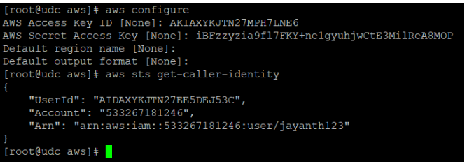
AWS
If you want to check s3 list – aws s3 ls
AWS – CLI Configure
Run the command : aws configure
Notes:
Ref : doc.html -> 1662 to

Slide 95
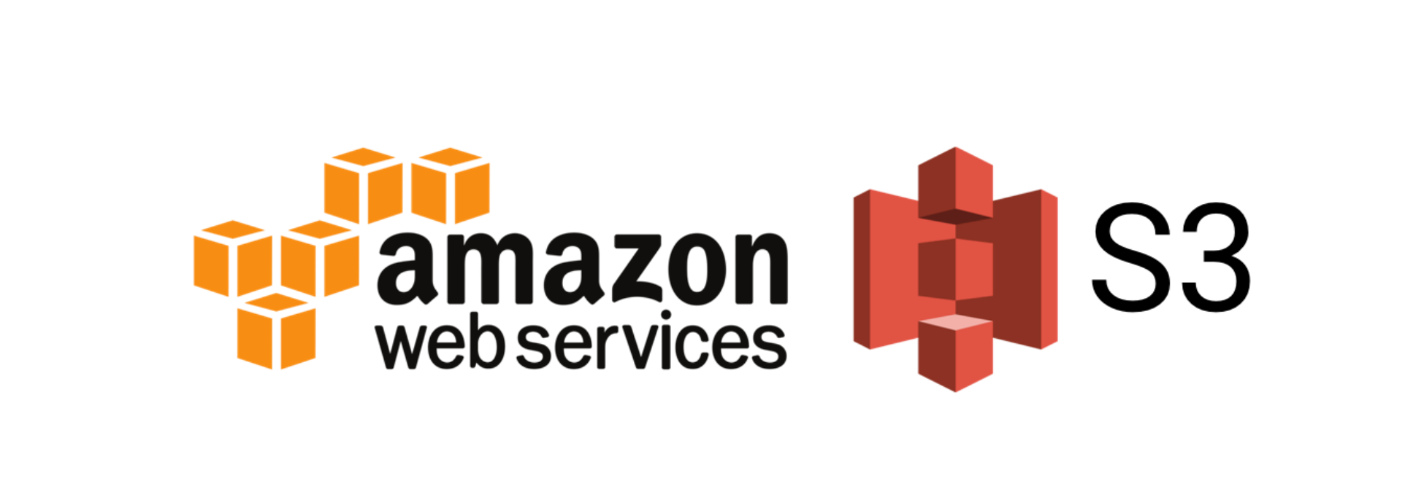
AWS
Notes:
Ref : doc.html -> 1662 to

Slide 96
AWS
What we are going to learn?
What is S3?
Benefits of S3
S3 Operations
Host a Static Website in S3
S3 Storage Classes
S3 Objects – Life Cycle Management Policy
S3 Versioning
S3 Replications
Notes:
Ref : doc.html -> 1662 to

Slide 97
AWS
What is S3?
Amazon Simple Storage Service (Amazon S3) is an object storage service that offers industry-leading scalability, data availability, security and performance.
Amazon S3 provides management feature so that you can optimize, organize and configure access to your data to meet your specific business, organizational and compliance requirements.
User can store and retrieve any type or amount of data (objects or files) in S3 over the web.
User can upload files from 0 bytes to 5 TB in size to S3 buckets (folder)
Bucket names must be unique across all AWS accounts in all the AWS regions within a partition.
Notes:
Ref : doc.html -> 1662 to

Slide 98
AWS
Benefits of S3
Unlimited Storage Space
Data High Availability – 99.99%
Data Durability – 99.99999999999%
Simple Interface – Web & CLI
Data Security
Notes:
Ref : doc.html -> 1662 to

Slide 99
AWS
S3 Operations
Create Bucket
Upload a file (object) and check properties
Enable Public Bucket Access
Accessing all objects in the bucket publicly
Deleting the objects
Notes:
Ref : doc.html -> 1662 to

Slide 100
AWS
How to create a Static website in S3?
Create a sample HTML file.
Create a bucket with Public access.
Upload the sample HTML file to the bucket.
Create a public access over the file (object ACL).
Create a public access over the bucket.
Notes:
Ref : doc.html -> 1662 to

Slide 101
AWS
S3 Storage Classes
S3 Standard
S3 Intelligent Tiering
S3 Standard IA (Infrequent Access)
S3 One Zone IA
S3 Glacier
S3 Glacier Deep Archive
Notes:
Ref : doc.html -> 1662 to

Slide 102
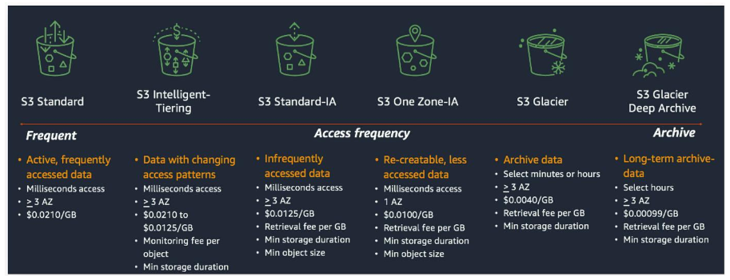
AWS
Notes:
Ref : doc.html -> 1662 to

Slide 103
AWS
Why S3 Storage Classes?
Amazon S3 offers a range of storage classes that you can choose from based on the data access, resiliency and cost requirements of your workloads.
S3 storage classes are purpose-built to provide the lowest cost storage for different access patterns. S3 storage classes fit virtually for any use case, including those with demanding performance needs, data residency requirements, unknown or changing access patterns, or archival storage.
Notes:
Ref : doc.html -> 1662 to

Slide 104
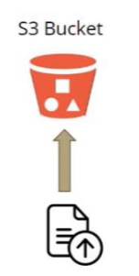
AWS
Keep in Mind !
S3 Standard
S3 Intelligent Tiering
S3 Standard IA (Infrequent Access)
S3 One Zone IA
S3 Glacier
S3 Glacier Deep Archive
Notes:
Ref : doc.html -> 1662 to

Slide 105
AWS
S3 Versioning
Versioning in AmazonS3 is means of keeping multiple variants of an object in the same bucket.
You can use the S3 versioning feature to preserve, retrieve and restore every version of every object stored in your buckets.
With versioning you can recover more easily from both unintended user actions and application failures.
After versioning is enabled for a bucket, if Amazon S3 receives multiple write requests for the same object simultaneously, it stores all of those objects.
Notes:
Ref : doc.html -> 1662 to

Slide 106
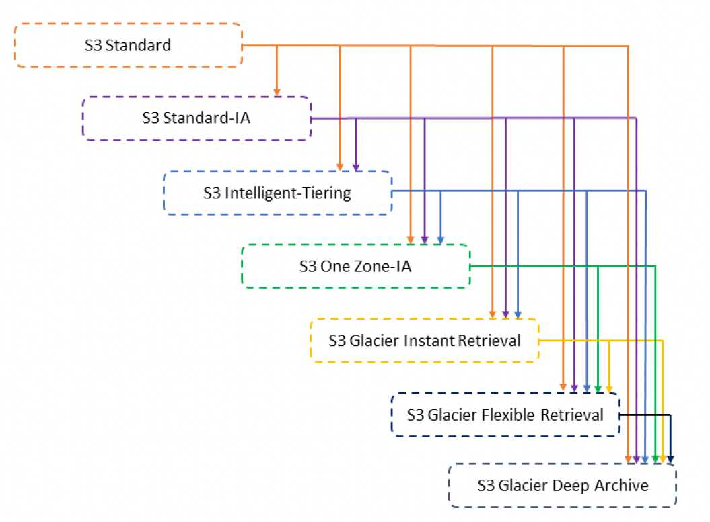
AWS
S3 – Object Lifecycle Management Policy
Notes:
Ref : doc.html -> 1662 to

Slide 107
AWS
S3- Replication Policy
Replication enables automatic, asynchronous copying of objects across Amazon S3 bucket
Buckets that are configured for object replication can be owned by the same AWS account or by different accounts.
You can replicate objects to a single destination bucket or to multiple destination buckets.
The destination buckets can be in different AWS regions or within the same region as the source bucket.
Notes:
Ref : doc.html -> 1662 to

Slide 108
AWS
Recap
Handling S3 buckets, files and it’s access.
S3 (public) static website configuration.
S3 storage class models and it’s pricing structure.
S3 versioning.
S3 Lifecycle Management Policy.
S3 Replication Policy.
Notes:
Ref : doc.html -> 1662 to

Slide 109
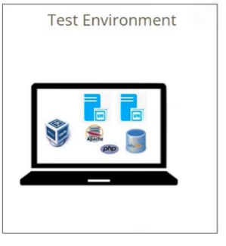
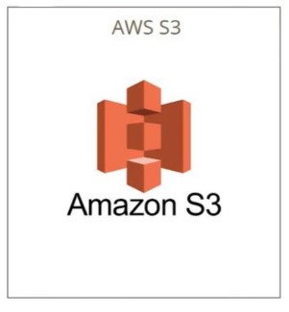
AWS
Project- User Data Collector- Web App
Notes:
Ref : doc.html -> 1662 to

Slide 110
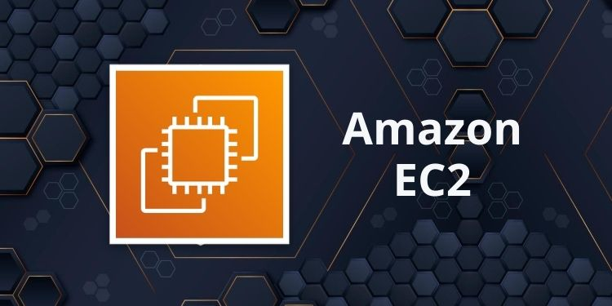
AWS
AWS – Elastic Compute Cloud
EC2
Notes:
Ref : doc.html -> 1662 to

Slide 111
AWS
EC2 – Introduction
It is a fundamental service in AWS
We can create Virtual Machines in AWS Data center (AZ | Regions)
AWS VM’s are secure and resizable with cloud benefits.
Here you can call VM(s) or Virtual machine(s) or Instance(s).
Different type of EC2 instances
Amazon EC2 offers different pricing models to accommodate various usage scenarios.
On- Demand Instances
Spot Instances
Reserved Instances
Dedicated Instances
Notes:
Ref : doc.html -> 1662 to

Slide 112
AWS
Different type of EC2 instances
On – Demand Instances | Spot Instances
You pay for compute capacity by the hour or second, with no upfront costs or long-term commitments. | User’s can bid for unused EC2 capacity, and if your bid exceeds the current spot price, your instances run. However, instances can be terminated if the Spot price rises above your bid.
It provide flexibility to scale up or down based on demand without any upfront commitments. | It is significantly cheaper than On- demand instances, making it cost effective for certain workload.
Notes:
Ref : doc.html -> 1662 to

Slide 113
AWS
Different type of EC2 instances
Reserved Instances | Dedicated Instances
Best for steady state, predictable workloads with a consistent usage pattern. It requires a commitment for a specific instance type in a region for a term of 1 or 3 years. Offers significant cost savings compared to On- Demand instances. | These instances run on hardware that is dedicated to a single AWS account, providing isolation from instances belonging to other accounts.
It provides capacity reservation for the chosen instance type in the specified region. | Suitable for customers who have specific compliance or regulatory requirements that mandate dedicated infrastructure.
Notes:
Ref : doc.html -> 1662 to

Slide 114



AWS
Let’s Launch the EC2 Instance(s)
Notes:
Ref : doc.html -> 1662 to

Slide 115
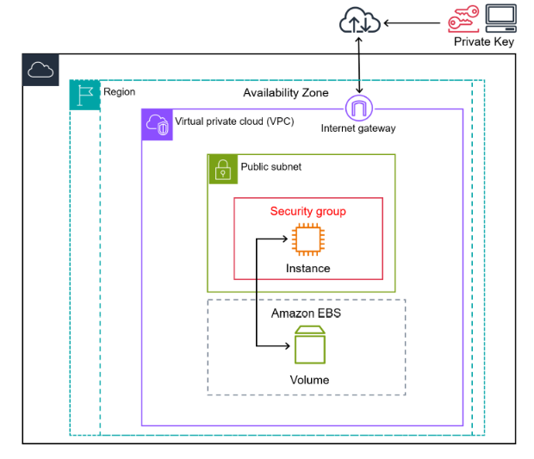
AWS
Notes:
Ref : doc.html -> 1662 to

Slide 116
AWS
EC2 Instance Creation – LINUX OS
Create Instance
You can choose Linux OS
Instance Type – t2.micro (free tier)
Create Key Pair and download it
Click allow SSH and HTTPS, HTTP Traffics
Click the create button and Connect to the instance
Download Putty Gen App (https://puttygen.com/download.php?val=49)
Open the Putty Gen and load your aws ec2 key into that
Notes:
Ref : doc.html -> 1662 to

Slide 117
AWS
EC2 Instance Creation – LINUX OS
Save the private Key
Now open the putty app
Hostname : ec2-user@public IP of your EC2 instance
Category – connection – auth – credentials – choose the private key
Connect the putty
-> sudo su (switch the user to root)
-> yum install httpd -y
-> service httpd start
And you can add file into /var/www/html and get your website
Notes:
Ref : doc.html -> 1662 to

Slide 118
AWS
EC2 Instance Creation – Windows OS
Create Instance
You can choose Windows OS
Instance Type – t2.micro (free tier)
Create Key Pair and download it
Click allow SSH and HTTPS, HTTP Traffics
Click the create button
Connect and RDP Client – Download remote file for windows
And open that file
Generate password and login
Notes:
Ref : doc.html -> 1662 to

Slide 119
AWS
Programmatic User Vs Roles
Roles are often preferred over programmatic access users in AWS because they provide a more secure and flexible way to grant permissions.
In Scenarios involving temporary access, the least privilege principle, and seamless integration with various AWS services.
Roles Importance
1. Create a Role with S3 full access
2. Go to instance – Actions – Security – Modify IAM Role
3. And update the IAM Role and Submit
4. Now you can use s3 in AWS instance -> aws s3 ls
5. Its very secured way of connection
Notes:
Ref : doc.html -> 1662 to

Slide 120
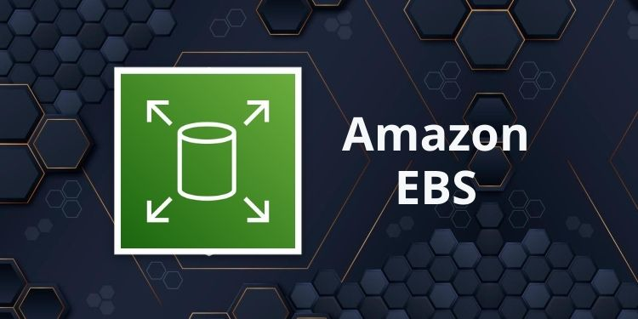
AWS
AWS – Elastic Block Storage
EBS
Notes:
Ref : doc.html -> 1662 to

Slide 121
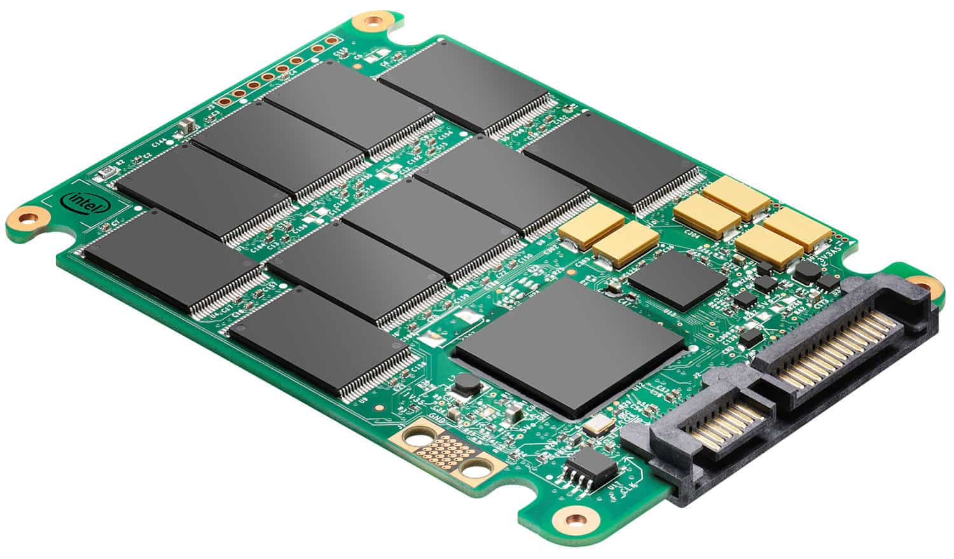

AWS
Permanent Storage Device
HDD SSD
Notes:
Ref : doc.html -> 1662 to

Slide 122
AWS
EBS
Amazon EBS provides block level storage volumes to use with EC2 instances. The volume is simply a virtual disk in a system.
You can mount these volumes as devices on your instances.
What is Block Level Storage volume?
The Block Storage system takes any data and divides it into blocks of equal sizes. Then stores the data block on underlying physical storage in a manner that is optimized for fast access and retrieval.
Notes:
Ref : doc.html -> 1662 to

Slide 123
AWS
Why we need to use EBS?
User can create a File System
User can run an Operating System
User can run Database
Install required applications (storing our own data)
Notes:
Ref : doc.html -> 1662 to

Slide 124
AWS
Advantages
HA – Highly Available
To protect hardware failure, it automatically replicated within single AZ
Designed for Product Environment
Dynamically Scalable
Increase capacity
Change the volume type
No downtime
There will be no performance issues to EC2
Notes:
Ref : doc.html -> 1662 to

Slide 125
AWS
IOPS | Throughput
The ability of read and write action in a very quick manner. | The ability to deal with large Datasets
It measures the number of read and write operations per second | It measures the bits read or written per second (MB/s)
Monitor using this metric to know about quick transactions, low latency apps, transactional workloads. | Monitor using this metric for large datasets, large I/O sizes and complex queries.
Recommended to choose IOPS SSD(io1 or io2) | Recommended to choose Throughput HDD (St1)
Notes:
Ref : doc.html -> 1662 to

Slide 126
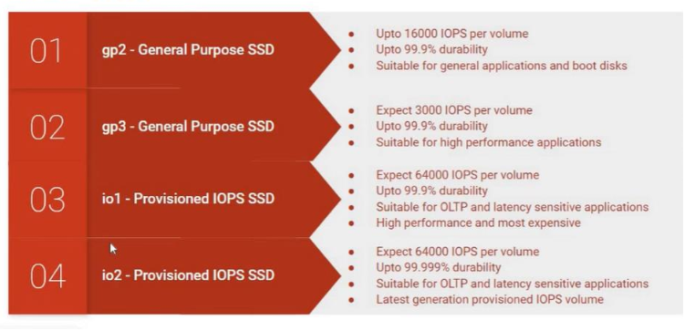
AWS
EBS - SSD
Notes:
Ref : doc.html -> 1662 to

Slide 127
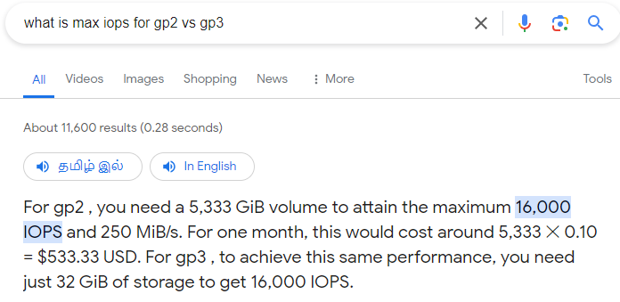
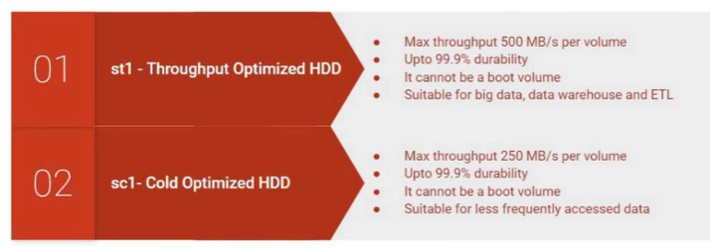
AWS
EBS - HDD
Notes:
Ref : doc.html -> 1662 to

Slide 128
AWS
Let’s jump in to AWS console
Let’s create an EC2 instance and configure our web application.
Assume, our web app is major hit but getting more performance related complaints.
And we need to do more deployments in other regions also
Need to change the storage volume type and size
Need to create new EC2 instance configure our web application in other region
Notes:
Ref : doc.html -> 1662 to

Slide 129
AWS
Questions
How to increase the volume size?
How to change the volume type?
How to deploy the same web application in another region?
How to take volume Snapshot?
How to create AMI using the volume snapshot?
Notes:
Ref : doc.html -> 1662 to

Slide 130
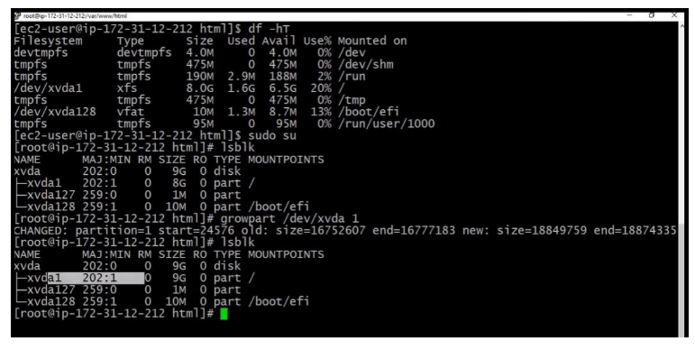
AWS
File System Changing Step 1 :
Notes:
Ref : doc.html -> 1662 to

Slide 131
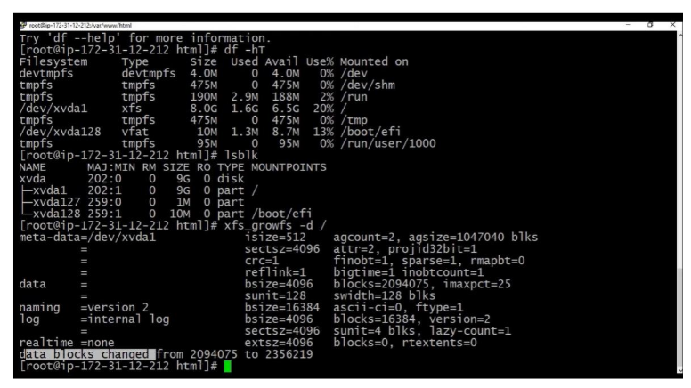
AWS
File System Changing Step 2 :
Notes:
Ref : doc.html -> 1662 to

Slide 132
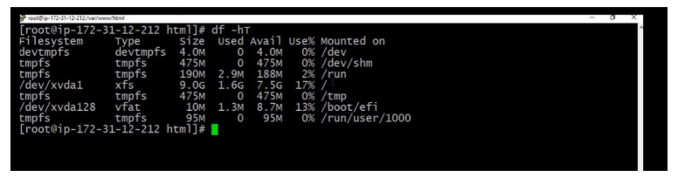
AWS
File System Changing Step 3 :
Notes:
Ref : doc.html -> 1662 to

Slide 133
AWS
Important Points !
The first snapshot will take some time to create.
You can share snapshots between AWS account as well as between regions.
On the go, you can increase EBS volume size and volume type.
Remember, snapshots copies the state of a system at a certain point in time, preserving a virtual picture of your server’s file system and settings.
Volumes exists in EBS and snapshots exists in S3.
Notes:
Ref : doc.html -> 1662 to

Slide 134

AWS
AWS – Elastic File System
EFS
Notes:
Ref : doc.html -> 1662 to

Slide 135
AWS
EFS
EFS volume can be mounted on many file systems.
1000’s of concurrent EC2 connections
It is a managed NFS – Network File System and it uses NFSv4 protocol.
EFS can handle 10 GBps in throughput.
EFS works with multiple availability zones.
It is expensive ( pay per use model), highly available and scalable.
It is scalable to Petabytes.
Currently compatible only with Linux AMI.
Notes:
Ref : doc.html -> 1662 to

Slide 136
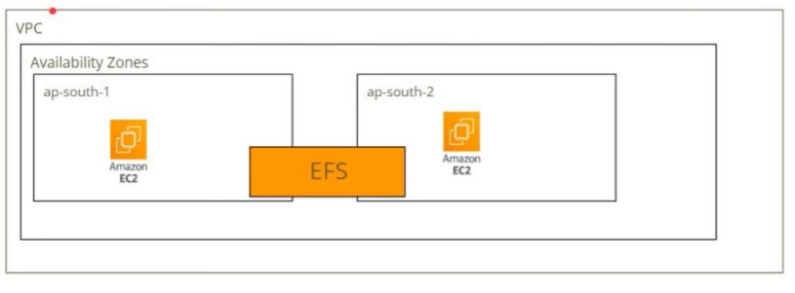
AWS
Plan
Notes:
Ref : doc.html -> 1662 to

Slide 137
AWS
Let’s jump in to AWS console
Let’s create an EC2 instances in ap-south-1 and ap-south-2 AZ.
Now we will install apache web server.
Lets create NFS security group for EFS.
Notes:
Ref : doc.html -> 1662 to

Slide 138
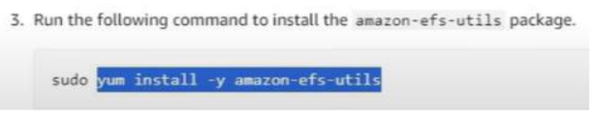
AWS
Let’s jump in to AWS console
We will configure web server SG only can access the NFS- EFS File System.
Let’s create a new EFS file system.
Now install the EFS utils package.
Notes:
Ref : doc.html -> 1662 to

Slide 139
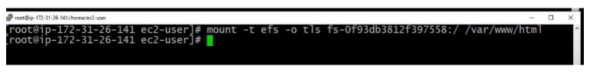
AWS
Let’s jump in to AWS console
In both EC2 instance, mount the EFS point in “/var/www/html” path.
In any one instance create a file in “/var/www/html” path
After mount – If you create files in anyone EC2 machine, it will get access and see in another EC2 machine (under /var/www/html location).
Notes:
Ref : doc.html -> 1662 to

Slide 140
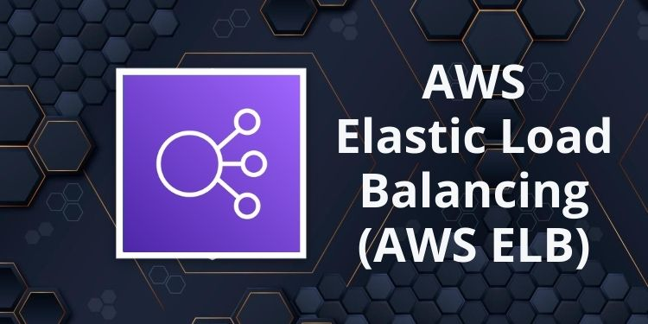
AWS
AWS – Elastic Load Balancing
Notes:
Ref : doc.html -> 1662 to

Slide 141

AWS
What is ELB?
It helps to automatically distributes incoming request/ traffic across multiple targets
(For Ex: Amazon EC2 instances).
We can do the same for multiple AZ’s.
Notes:
Ref : doc.html -> 1662 to

Slide 142
AWS
How LB works?
We need to know about important 3 things,
Health Check
Listeners
Rules
Notes:
Ref : doc.html -> 1662 to

Slide 143
AWS
Health check
All LB’s can be configured health checks.
HC periodically send requests to load balancers registered instances.
Those requests will help to test/ known their status(healthy or unhealthy).
Based on the response, it will mark the instance state.
“InService” = when it detect instances are healthy state.
“OutofService” = No response from instance then it will mark it as unhealthy.
Notes:
Ref : doc.html -> 1662 to

Slide 144
AWS
Types of Load Balancers
Classic Load Balancer
Application Load Balancer
Gateway Load Balancer
Network Load Balancer
Notes:
Ref : doc.html -> 1662 to

Slide 145
AWS
Classic Load Balancers
The name itself tells you that, it is an old load balancer.
We can add HTTP/HTTPS applications.
It uses layer 7 specific features.
Notes:
Ref : doc.html -> 1662 to

Slide 146
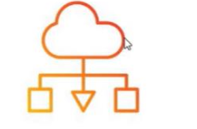

AWS
Plan
Classic Load Balancer
web server 1 web server 2
Notes:
Ref : doc.html -> 1662 to

Slide 147
AWS
Application Load Balancer
It is an Intelligent Load Balancer.
It is very much suited for balancing the HTTP/HTTPS traffic.
It is working at Layer 7 and you configure this LB to make decisions to balance the traffic between EC2 instances.
Notes:
Ref : doc.html -> 1662 to

Slide 148
AWS
Listeners
A Listener check for connection requests from clients using the port and protocol which we configure in the LB.
We can define rules to tell LB to route the requests to the targets/ instances.
Each rule consists of condition, action and priority.
Notes:
Ref : doc.html -> 1662 to

Slide 149
AWS
Rules
When the conditions for a rule are met then, its actions are performed.
User must define the “default” rule for a listener.
And user can optionally, can configure additional rules.
Notes:
Ref : doc.html -> 1662 to

Slide 150

AWS
AWS – Auto Scaling
Notes:
Ref : doc.html -> 1662 to

Slide 151







AWS
What is Auto Scaling?
It helps you to scale your environment to what we need it to be.
It allows you to have only what you need in your environment.
Notes:
Ref : doc.html -> 1662 to

Slide 152
AWS
Two types of Auto Scaling?
Vertical Scaling
In the vertical scaling allows you to increase the machine’s capacity while maintaining resources within the same logical unit.
The processor, memory, storage and network capacity are increased in this approach.
Horizontal Scaling
Horizontal scaling is an approach of adding more devices to the infrastructure to increase the capacity and efficiently handle increasing traffic demands.
Notes:
Ref : doc.html -> 1662 to

Slide 153
AWS
How does it work?
Auto – Scaling Group
Automatic Integration
Create AS policy across collection of EC2 instances through Launch Templates.
AS Group automatically maintain a fixed number of instances.
Constant Health Checks
With health checks in place, unhealthy EC2 instances will be terminated and replaced as needed to your desired capacity.
Notes:
Ref : doc.html -> 1662 to

Slide 154


AWS
Scenario & Plan
Notes:
Ref : doc.html -> 1662 to

Slide 155
AWS
How to Increase CPU Stress?
1.Top – command for checking CPU usages
2. Yum install stress -y
3. lscpu – command for check the status as how many CPU is available
4. stress --CPU 1 – this command makes CPU into more stress
5. Again, check the lscpu command and you can see the load of CPU
Notes:
Ref : doc.html -> 1662 to

Slide 156

AWS
AWS – Relational Database Service
RDS
Notes:
Ref : doc.html -> 1662 to

Slide 157




AWS
What is Relational Database?
A Relational Database organizes data into rows and columns, which collectively form a table.
Data is typically structured across multiple tables, which can be joined together via a primary key or a foreign key.
Database Tables Rows Columns
Notes:
Ref : doc.html -> 1662 to

Slide 158
AWS
Example
ID | Name | Item | Country | Address | Status
1 | Muthu | Pen | USA | 123,xxxx,xx,x | Delivered
2 | Stephen | Smart Phone | England | 456,xxxx,xx,x | In Transits
3 | Mohammed | Home Theatre | Dubai | 789,xxxx,xx,x | Delivered
Notes:
Ref : doc.html -> 1662 to

Slide 159







AWS
Different DB’s availability with AWS
Notes:
Ref : doc.html -> 1662 to

Slide 160
AWS
Where we can use RDS?
RDS is generally used for OLTP – Online Transaction Processing Workloads.
Process data from transactions in real time.
Customer orders
Banking Transactions
Ticket – Booking Transactions
Notes:
Ref : doc.html -> 1662 to

Slide 161
AWS
Advantages of using RDS?
It will be up and running in few minutes.
Failover capability.
Multi – AZ.
Automated backups.
Notes:
Ref : doc.html -> 1662 to

Slide 162
AWS
How to create RDS?
Let’s jump into AWS console……
Plan:
1.Need to create RDS instance with MySQL as free tier
2. Create one EC2 instance
3. Run a command : dnf install mariadb105
4.MariaDB and MySQL both are same community circle only
5. yum install MariaDB
6. MySQL -h endpoint -P port number -u username -p
7. If after password show error, Go to security group and change the inbound rules of RDS SG as MySQL and choose the RDS security group.
Notes:
Ref : doc.html -> 1662 to

